Slide 1
Jazz (1900 - 1950)
Kenny Lim

Slide 2
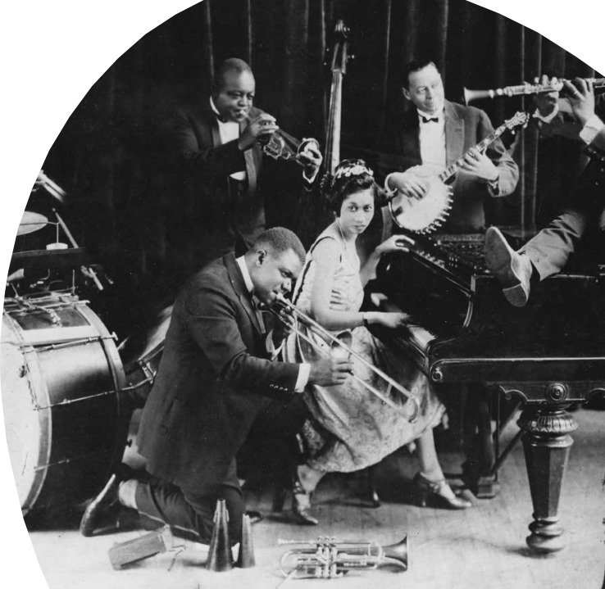
Jazz
•About the time Schoenberg and Stravinsky were changing the language of music in Europe, a new musical style called jazz was being developed in the United States
•Originated from New Orleans
•Based on Improvisation
•No one knows exactly when Jazz started, because it’s a type of music that exists only in performance, not written.
•For a long time it was a intended for dancing, but after 1940s it was more for listening
Notes:
•About the time Schoenberg and Stravinsky were changing the language of music in Europe, a new musical style called jazz was being developed in the United States
•Originated from New Orleans
•Based on Improvisation
•No one knows exactly when Jazz started, because it’s a type of music that exists only in performance, not written.
•For a long time it was a intended for dancing, but after 1940s it was more for listening

Slide 3
Characteristics
Rhythms
Back bone of Jazz
Syncopated and swing rhythms
4 beats to a bar

Slide 4
Instruments
More emphasis on wind and brass
Main instruments: Cornet, trumpets, saxophone, piano, clarinet, vibraphone & trombone
Rhythm section: Piano, plucked double bass, percussion (Drumset), banjo/guitar

Slide 5
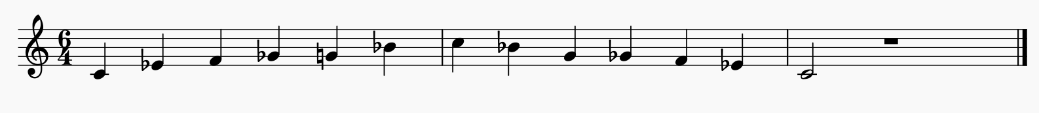

Melody
Flexible (Improvisation)
Major & minor scales
Blues scales: always lower/flatten the 3rd/5th/7th

Slide 6
Chords
Traditional tonal system
Throughout the years, harmonic volcabulary become increasingly complex, sophisticated and chromatic.
Often uses 5 to 6 note chords that sound rich and lush

Slide 7
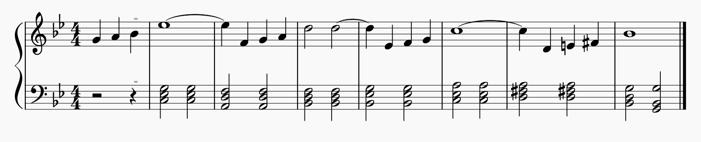
Autumn Leaves
Cmin Dmin Bbmaj Ebmaj Amin Dmaj Gmin

Slide 8
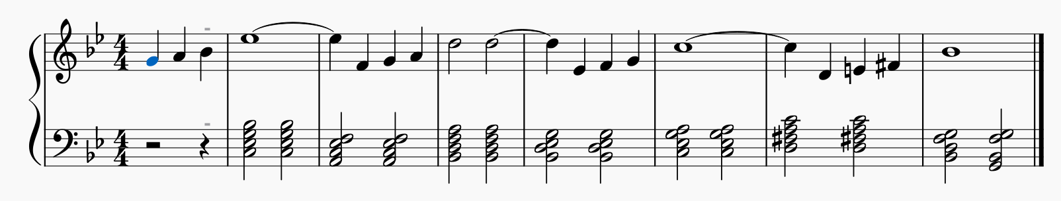
With 7th Chords
Cmin7 F7 Bbmaj7 Ebmaj7 Amin7 D7 Gmin7

Slide 9
Improvisation
Creation of music at the time it is performed
Without any specific notations
According to the series of chords given
Use blue scales, major/minor etc.
Each soloists will take turns to improvise
A jazz improvisation is usually in theme-and-variation form

Slide 10
Improvisation form
Each statement of the basic harmonic pattern or melody is called chorus
In a jazz performance that is based on a 32 bar melody might be outlined as follow:
Chorus 1 (32 bars) Theme
Chorus 2 (32 bars) Variation 1
Chorus 3 (32 bars) Variation 2
Chorus 4 (32 bars) Variation 3
Chorus 4 (32 bars) Variation 4
Chorus 5 (32 bars) Theme

Slide 11
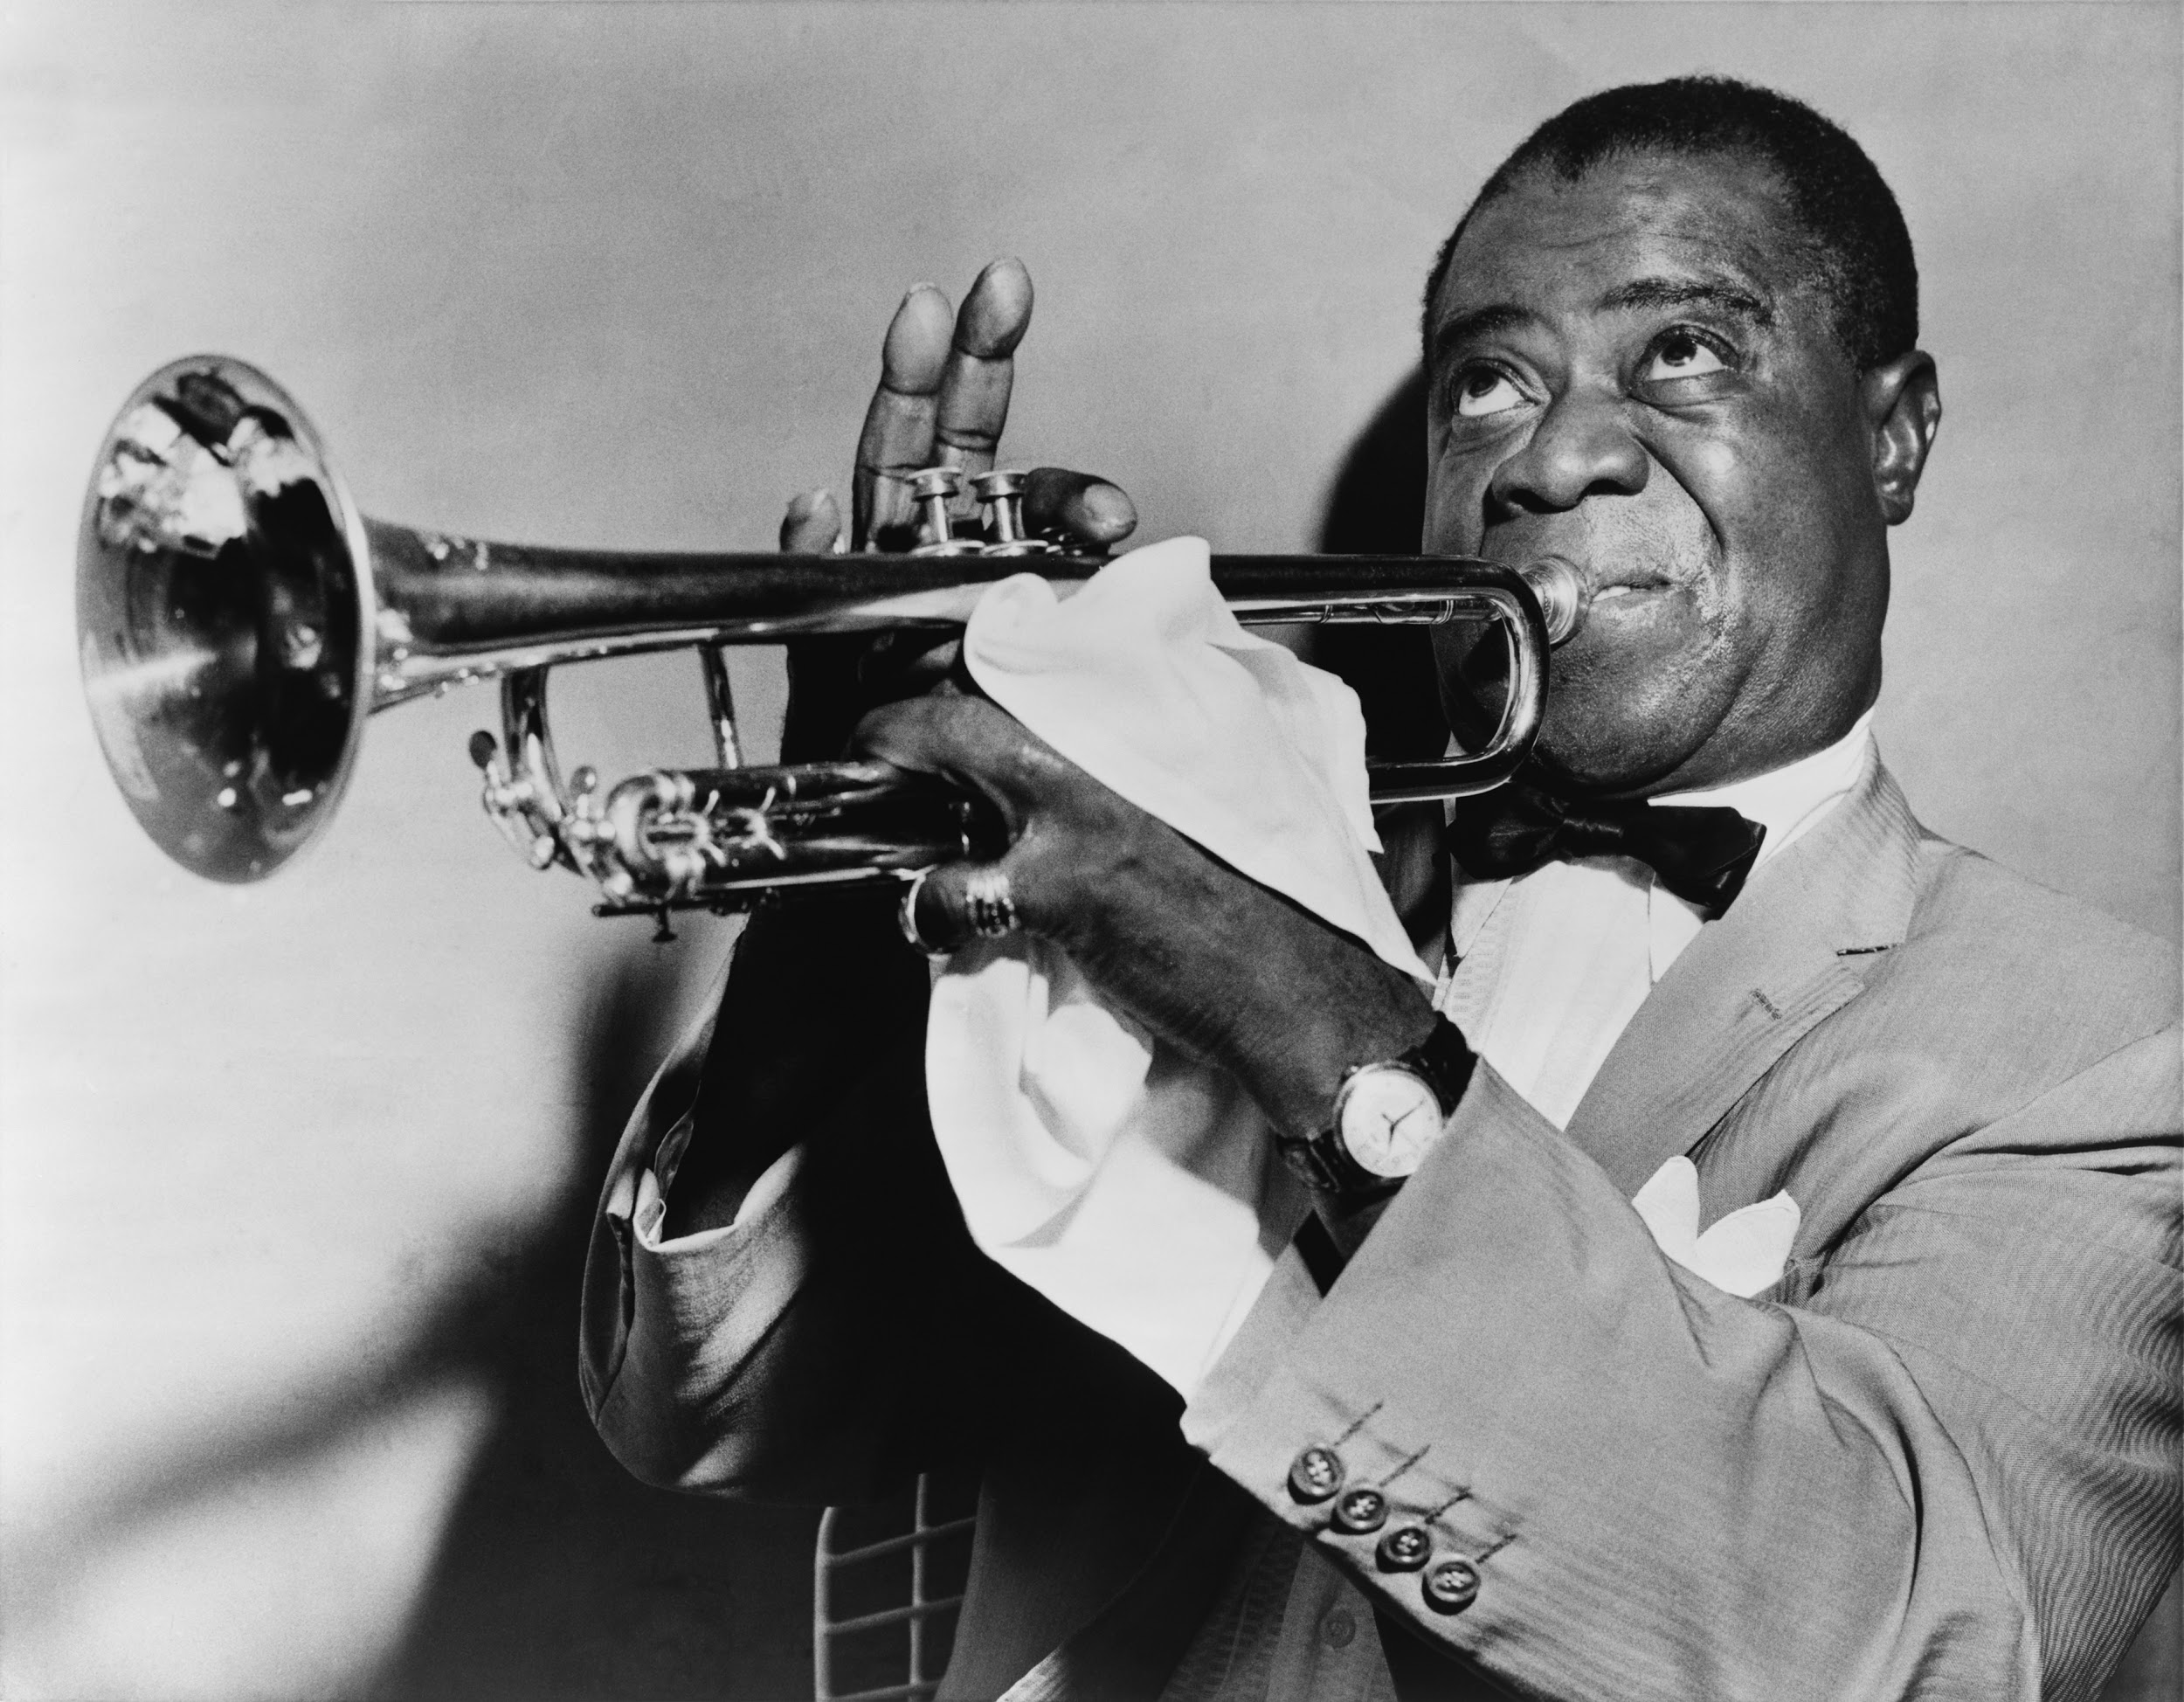
Jazz styles
Ragtime
Blues
New Orleans
Swing
Bebop

Slide 12
Ragtime
A style of composed piano music that flourished from the 1890s to about 1915
Developed primarily by African American pianists who traveled in the Midwest and south playing in saloons and dance halls
It is generally in duple meter
Performed in a moderate march tempo
Right hand plays a highly syncopated melody, while the left hand steadily maintains the beat with an “oom-pah” accompaniment
Normally contains several melodies that are similar in character
Forms: AA BB A CC DD or Introduction – AA BB CC DD EE

Slide 13
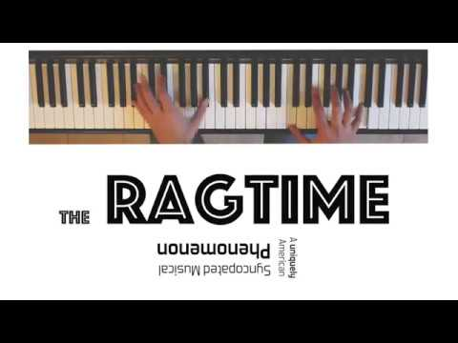

Slide 14
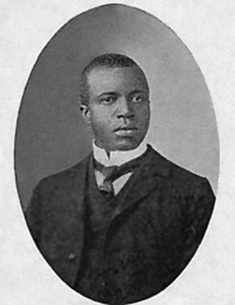
Scott Joplin (1868 - 1917)
King of ragtime
Trained in “classical” music and wrote a ballet and two operas, as well as many piano rags (term used for ragtime)
Maple leaf Rag & The Entertainer

Slide 15
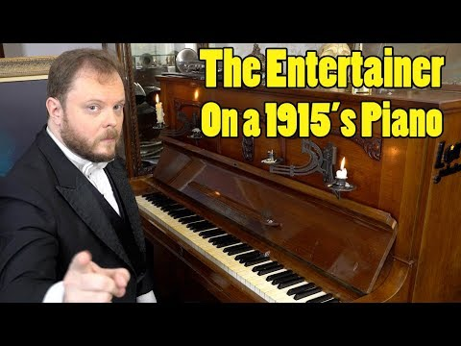

Slide 16
Blues
The most important foundation of jazz
Grew out of African American folk music, such as work songs, spirituals, and the field hollers of slaves.
Vocal blues is intensely personal, often containing sexual references and dealing with the pain of betrayal, desertion, and unrequited love
Music is almost in quadruple meter
Poetic lyric
Normally have lyrics such as ‘baby’ or ‘honey, etc.

Slide 17
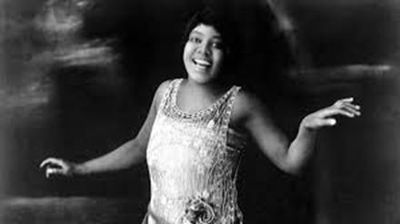
Bessie Smith (1894 - 1937)
Known as the “Empress of the blues”

Slide 18
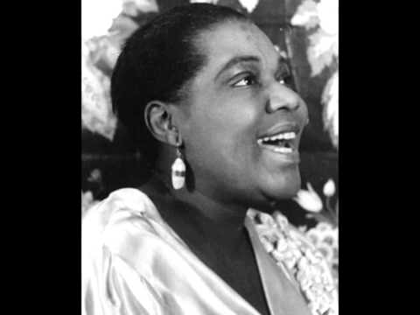

Slide 19
New Orleans Style
Based on march/ church melodies, ragtime piece, popular songs/ 12-bar blues
Use scat singing = singing with lyrics without meaning
Jazz in New Orleans style (or Dixieland) was typically played by a small group of five to eight performers.

Slide 20
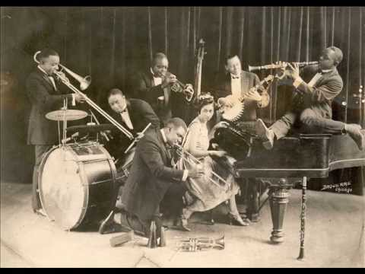
King Oliver’s Creole Jazz Band
Based on 12-bar blues
Trumpet solo is widely imitated due to it’s “blue” note and syncopations

Slide 21
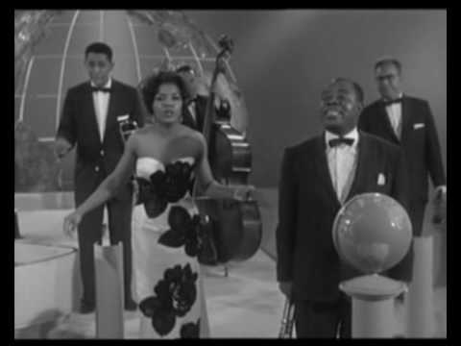

Louis Armstrong (1901 – 1971)
Second cornist in King Oliver’s Creole Jazz Band
At the age of 64, he had his greatest popular success, the hit recording Hello, Dolly! (number one in 1964)

Slide 22
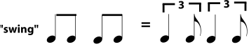
Swing
Developed in the 1920s and flourished from 1935 to 1945, a decade nicknamed the “swing era”
Mainly played by big bands
Around 14-15 musicians
Three sections:
Saxophone (3/5 players)
Brass instruments )3/4 trumpet and trombones)
Rhythm section (piano, percussion, guitar and bass)
Music was composed or arranged rather than improvised

Slide 23
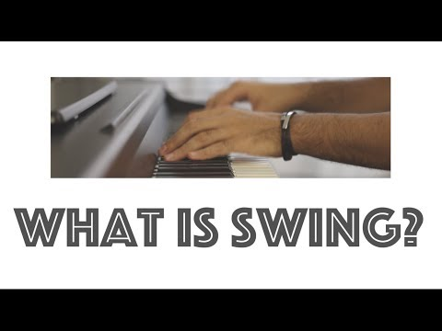

Slide 24
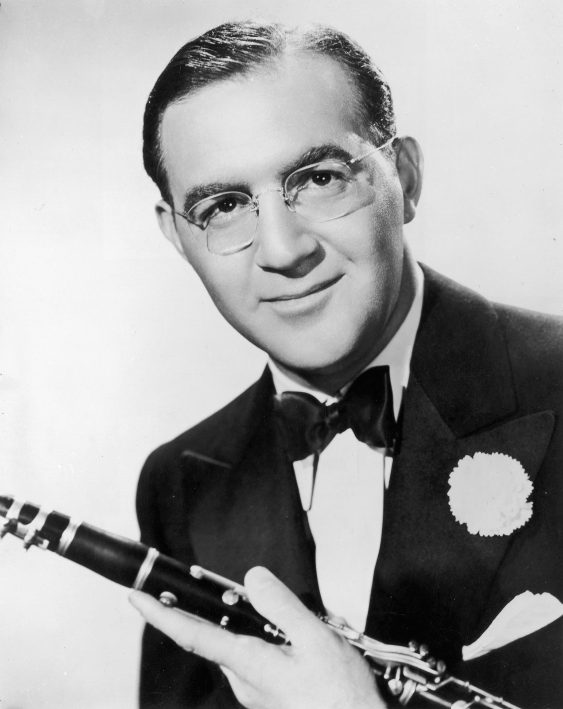
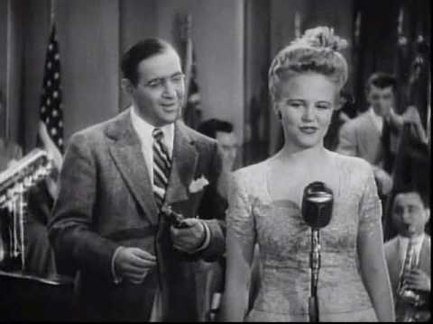
Benny Goodman (1909 – 1986)
King of swing
Leads the most popular musical group in the 1930s in United States
1938 concert in Carnegie Hall sets one of the most important performance in jazz history

Slide 25
Bebop
A complex style of music usually for small jazz groups consisting 4 -6 player
Often extremely fast beat
Meant for attentive listening, not dancing, and it’s sophisticated harmonies and unpredictable rhythms bewildered many listeners

Slide 26
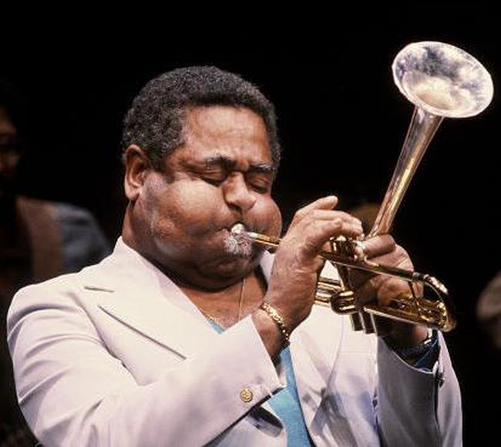
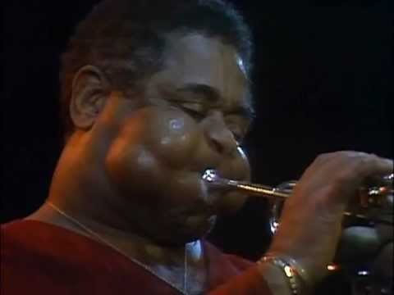
Dizzy Gillespie (1917 – 1993)
A night in Tunisia (composed 1942)
“I sat down at the piano to improvise some chord changes… The melody had a Latin, even oriental feeling to it… a special kind of syncopation in the bass line.” – Dizzy Gillespie

Slide 27
Jazz Styles since 1950
Cool Jazz
Free Jazz
Jazz Rock

Slide 28
Cool Jazz
Related to bop but was far calmer and more relaxed in character
Leaders: Lester Young and Stan Getz
Gentle attack and little vibrato
Tended to be longer than bebop works and relied more heavily on arrangements
Sometimes uses instruments that were new to jazz such as French horn, flute and cello

Slide 29
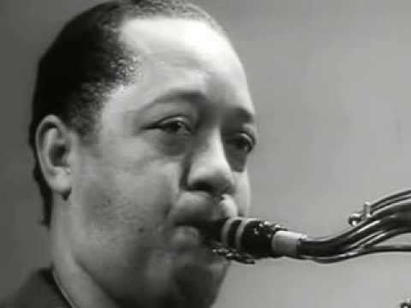

Slide 30
Free Jazz
A style that is not based on regular forms or established chord patterns
Random-nesss
Solo section of different length
Improvisation by multiple players at once
Ornette Coleman and John Coltrane

Slide 31
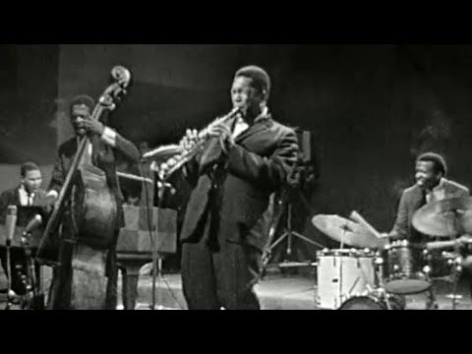

Slide 32
Jazz Rock
Late 1960s rock became a potent influence to jazz
Jazz Rock or Fusion
Includes acoustic winds and brass instruments along with synthesizers and electric piano, guitar and bass
Style combined improvisations with rock rhythms and tone colors

Slide 33
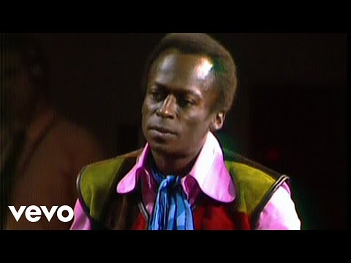
Miles run the voodoo down

Slide 34
Have a Jazzy weekend!

